Slide 1
BCCA figures
March 13 2025

Slide 3
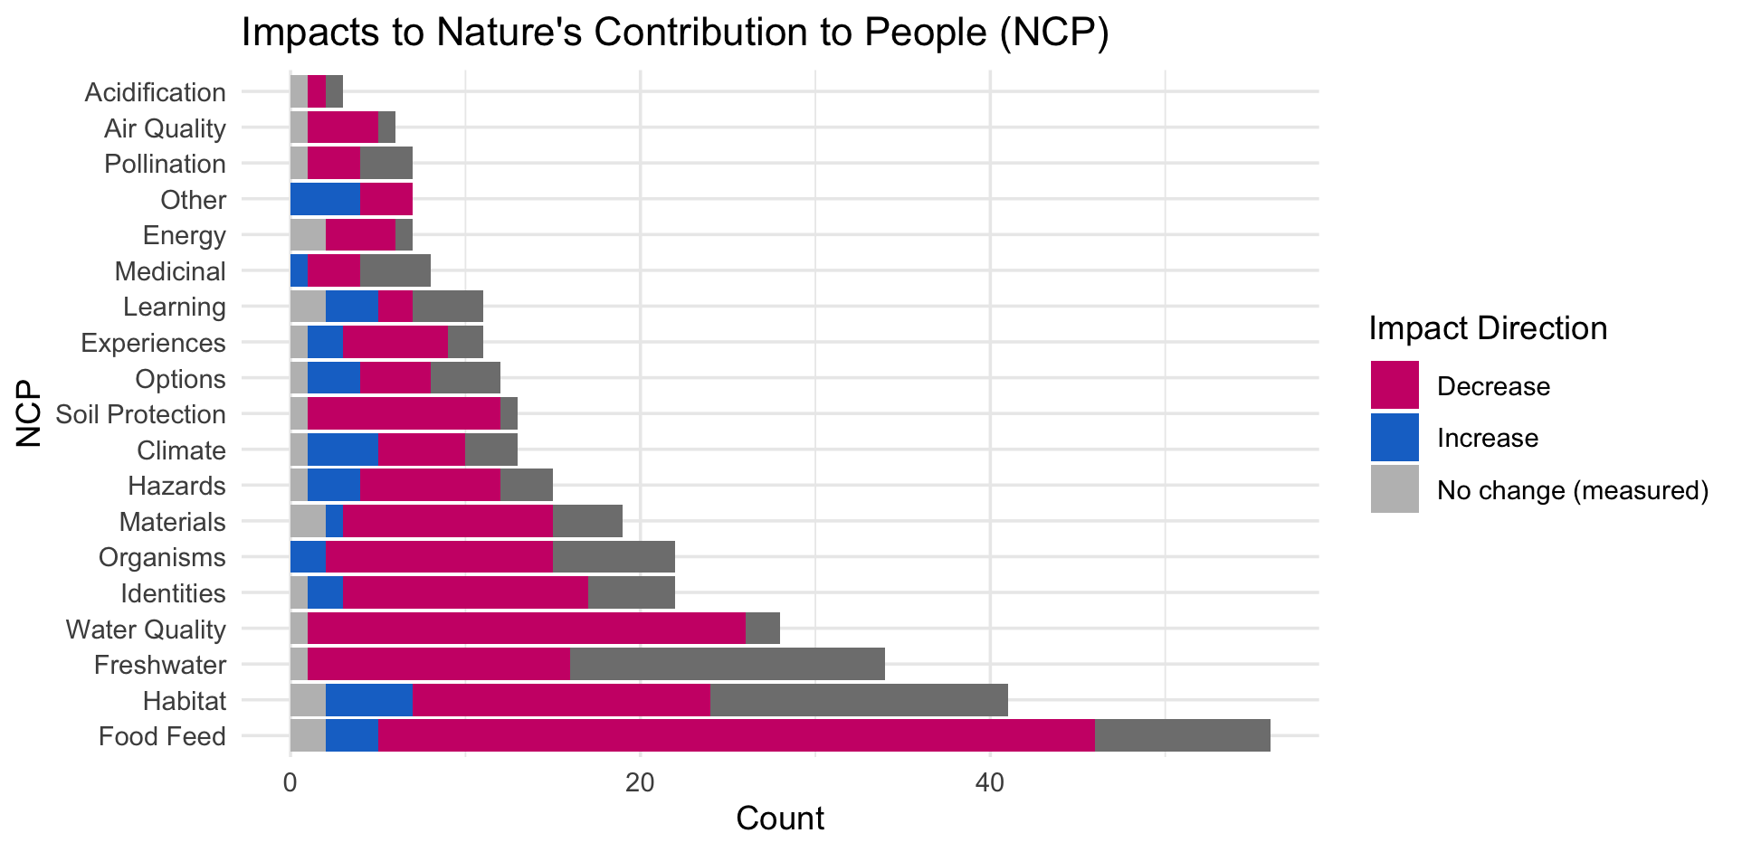

Slide 5
OLDER:

Slide 7
At least 5 entries – top – to get stats on % of entries or papers on these:

Slide 8
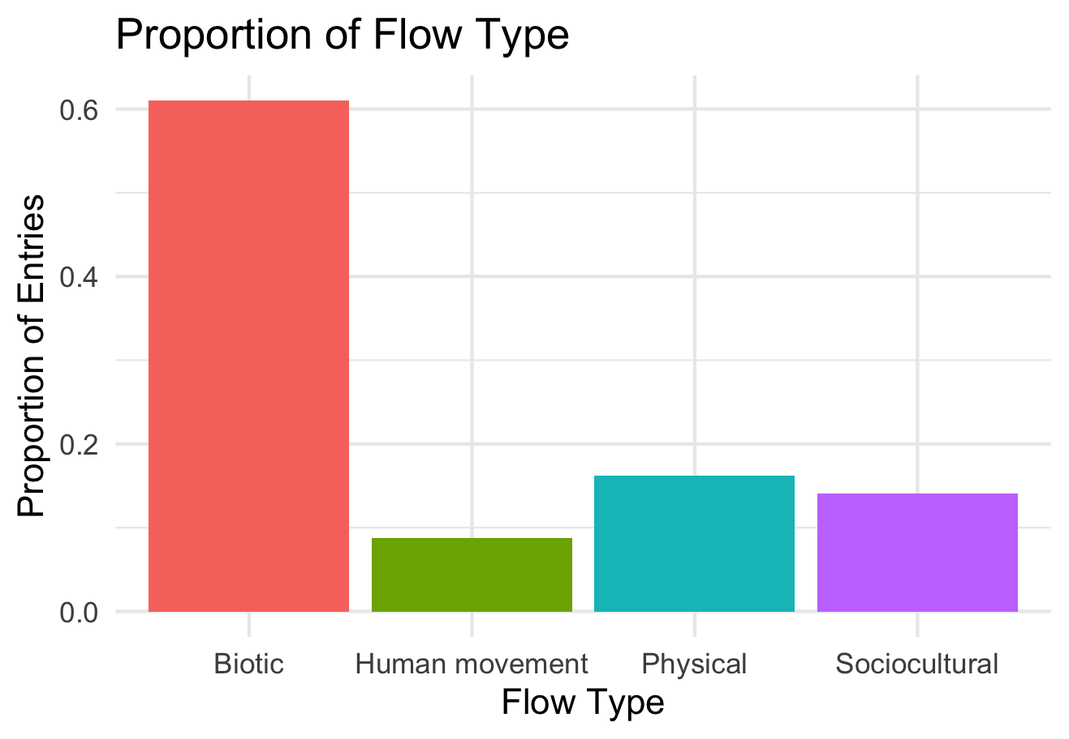

Slide 9
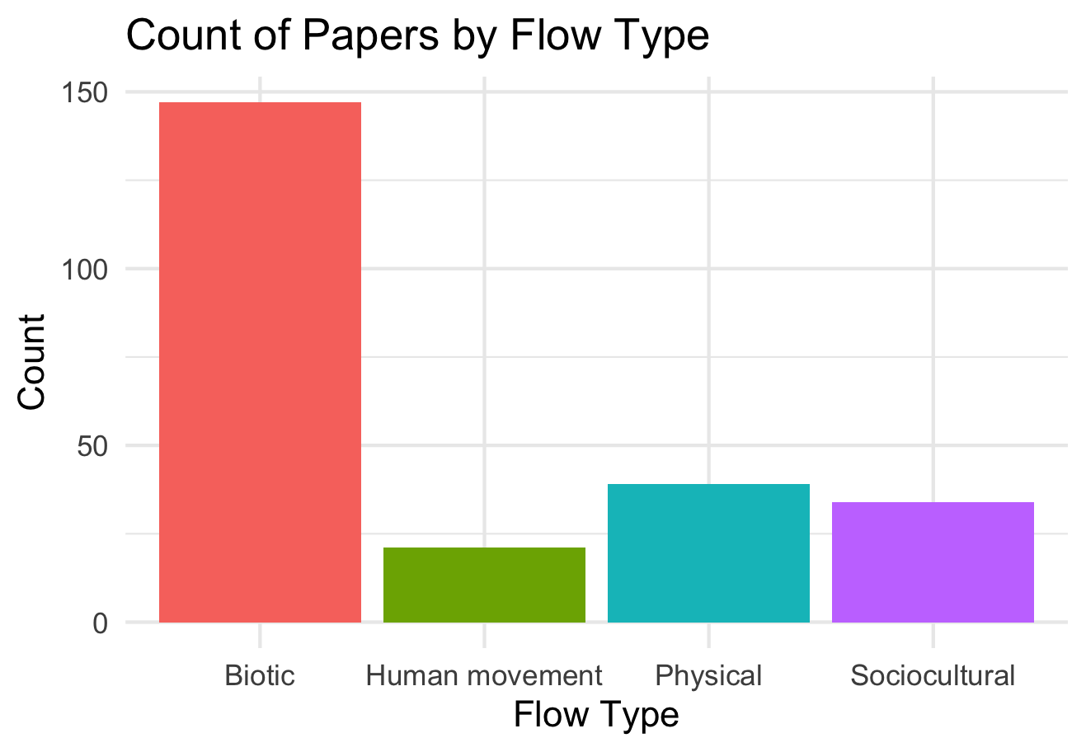

Slide 10
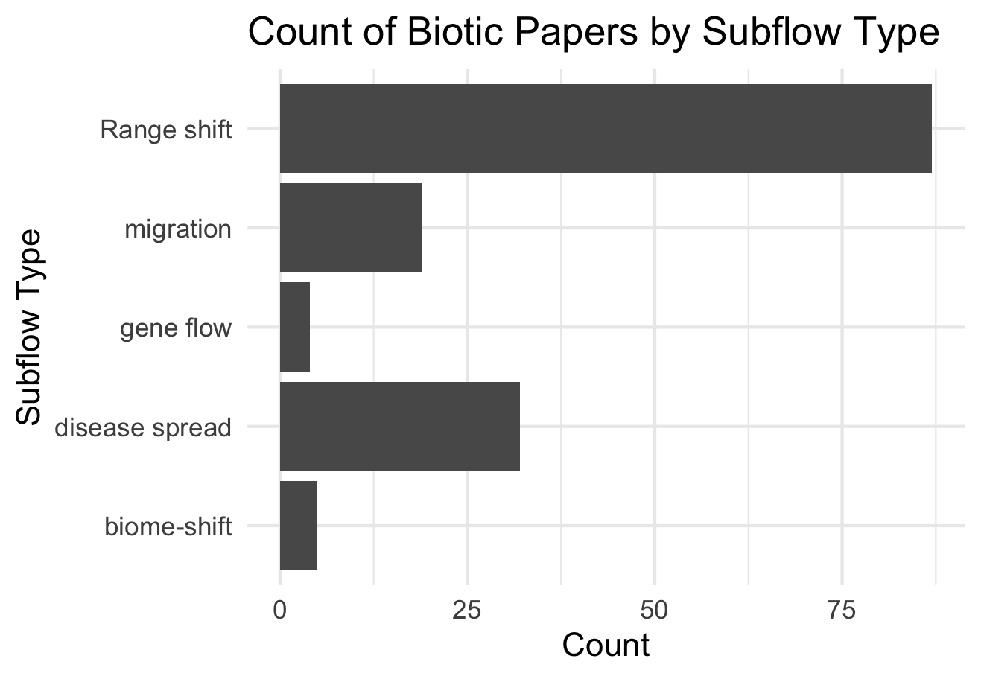

Slide 11
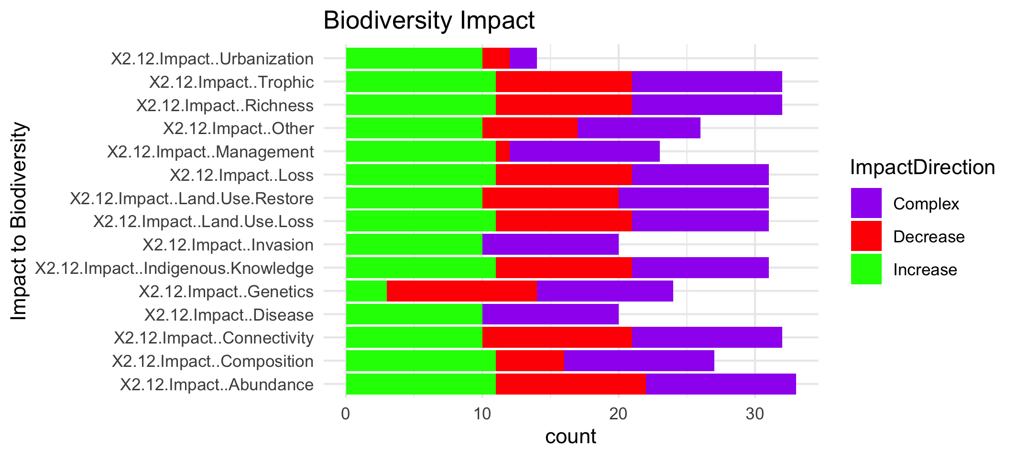

Slide 13
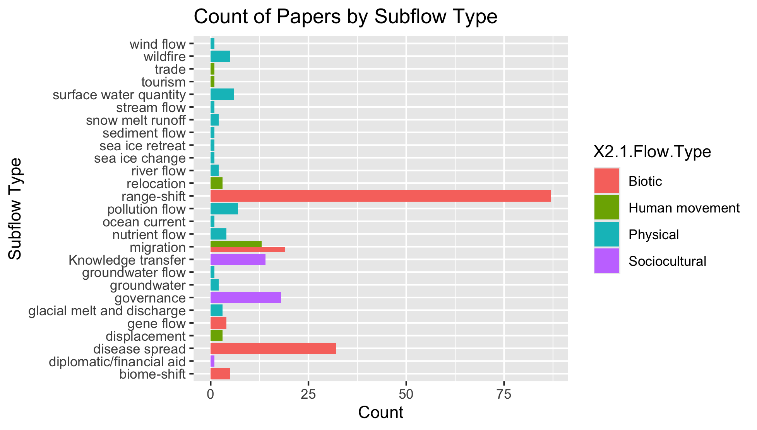
To group physical flow papers

Slide 14
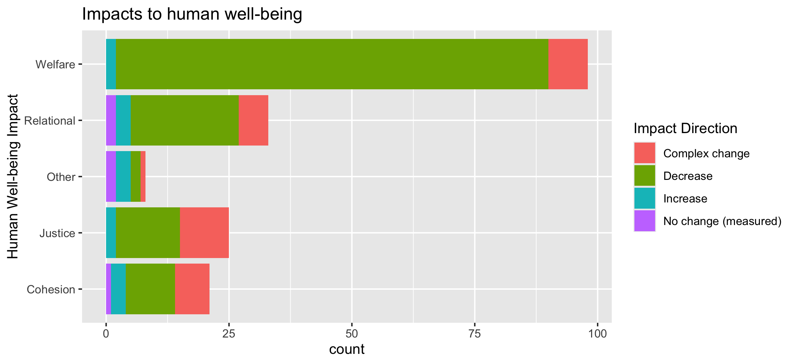
To align direction colors with final color pallet

Slide 15
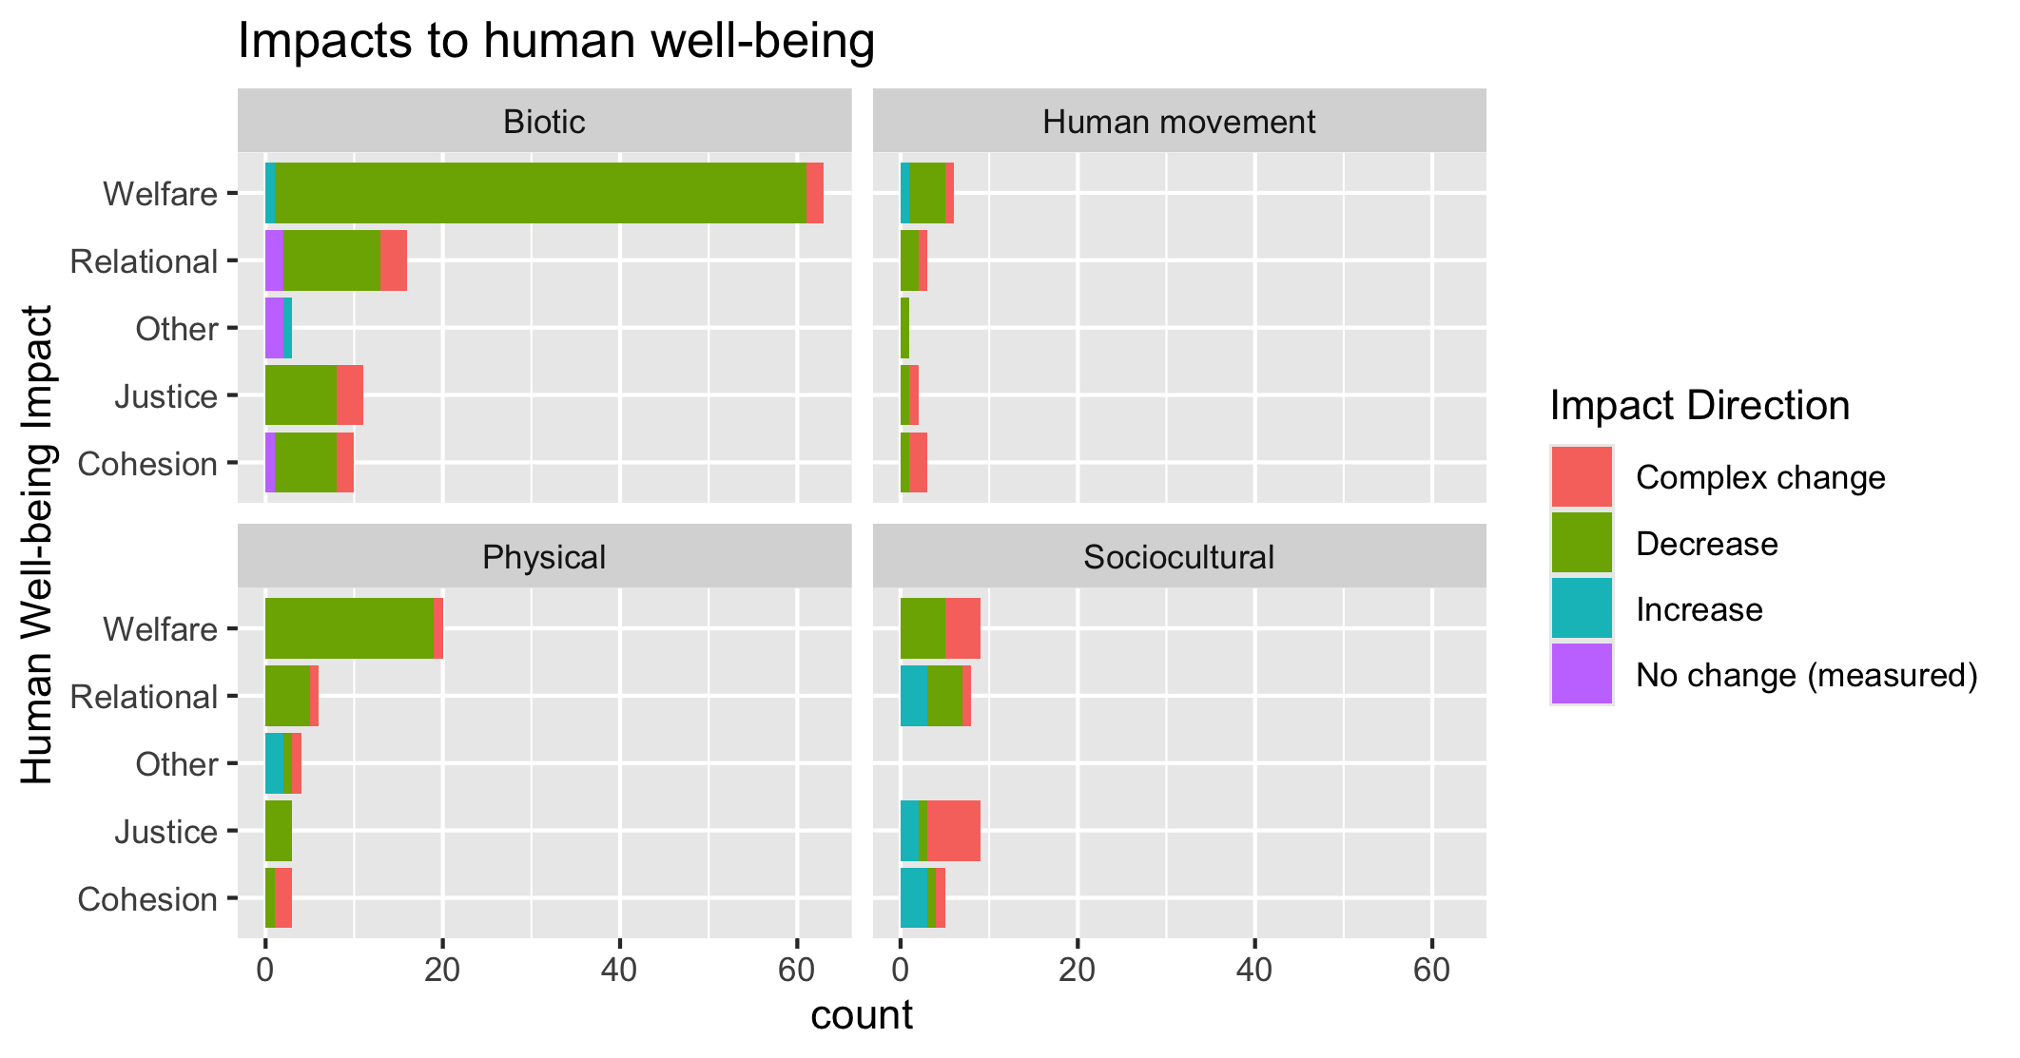
To align direction colors with final color pallet

Slide 16
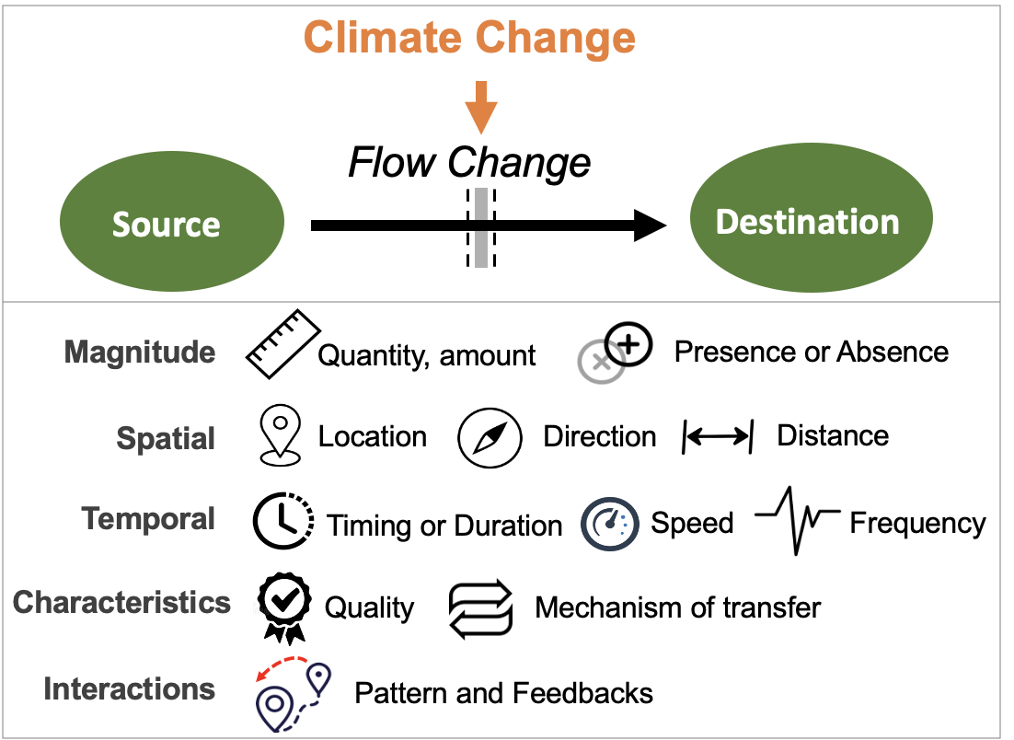
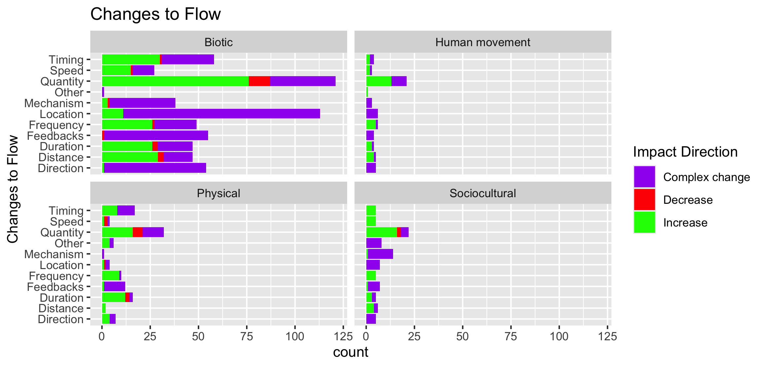

Slide 17
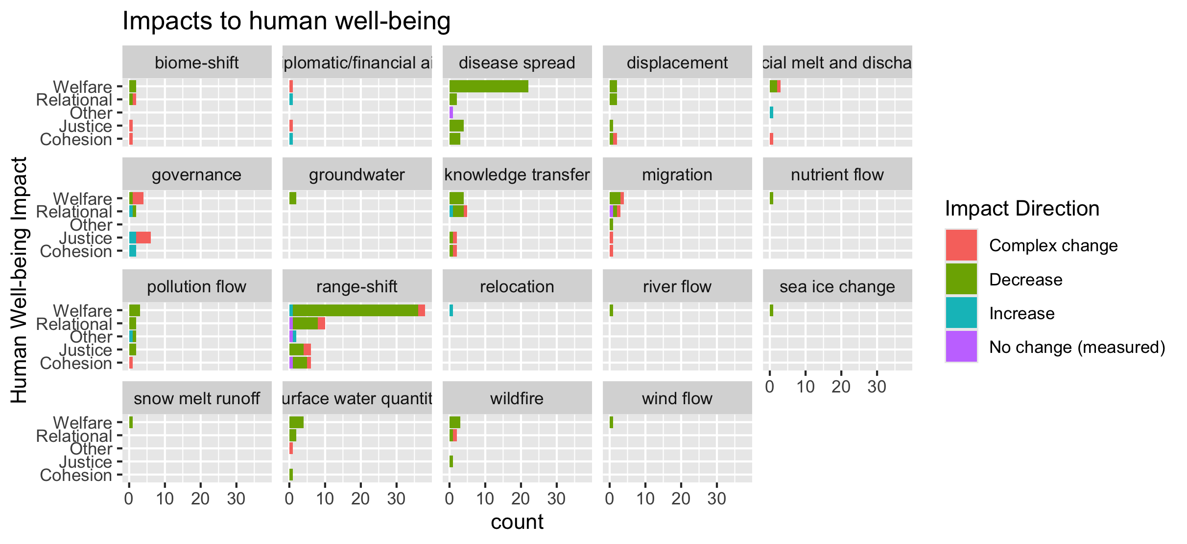
To group physical flow papers

Slide 18
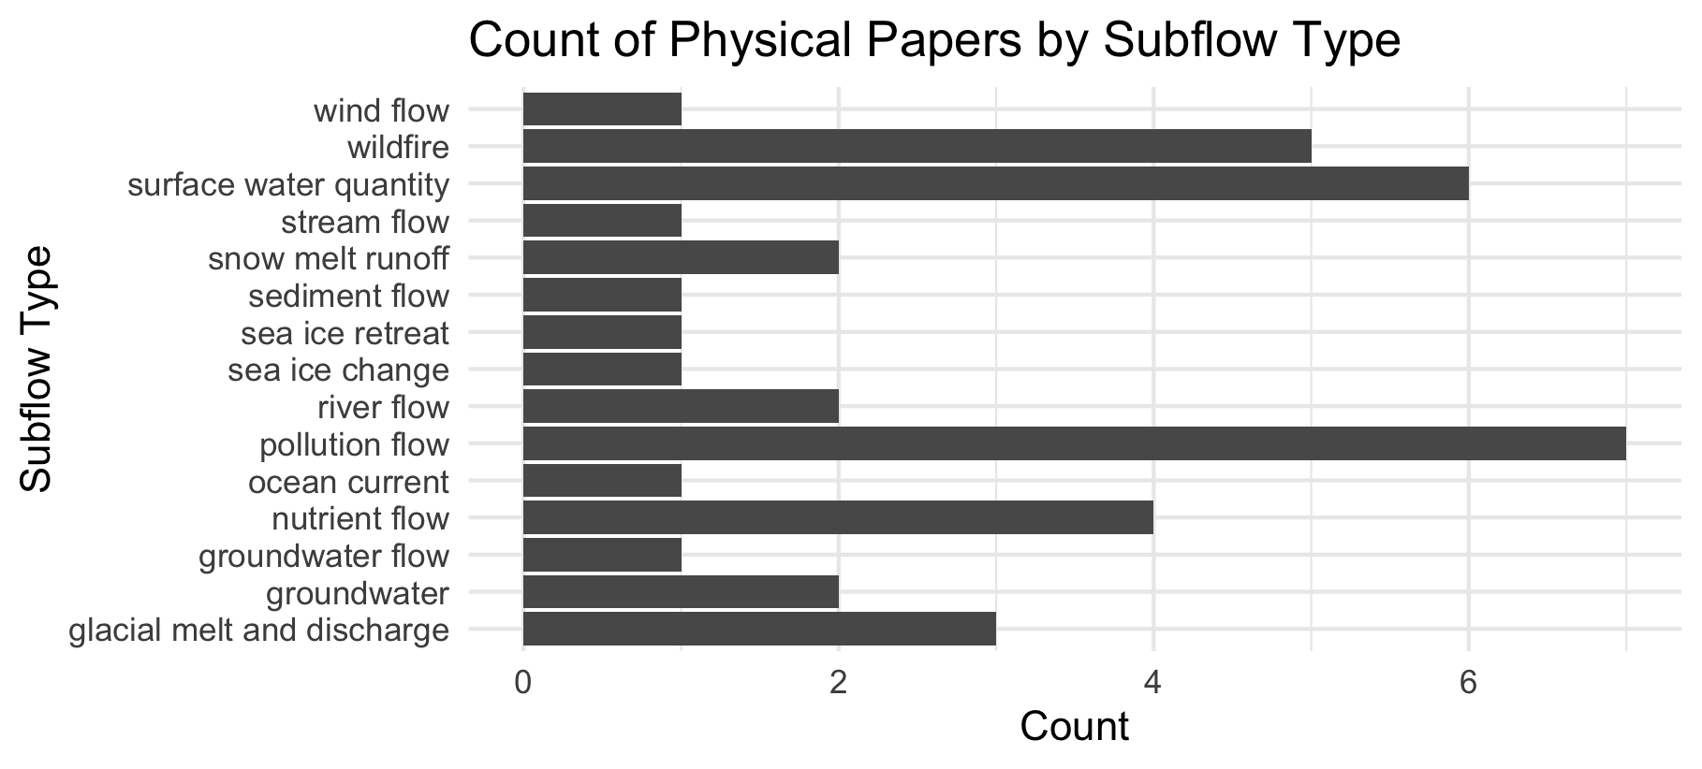

Slide 19
Feb 23 2025

Slide 20
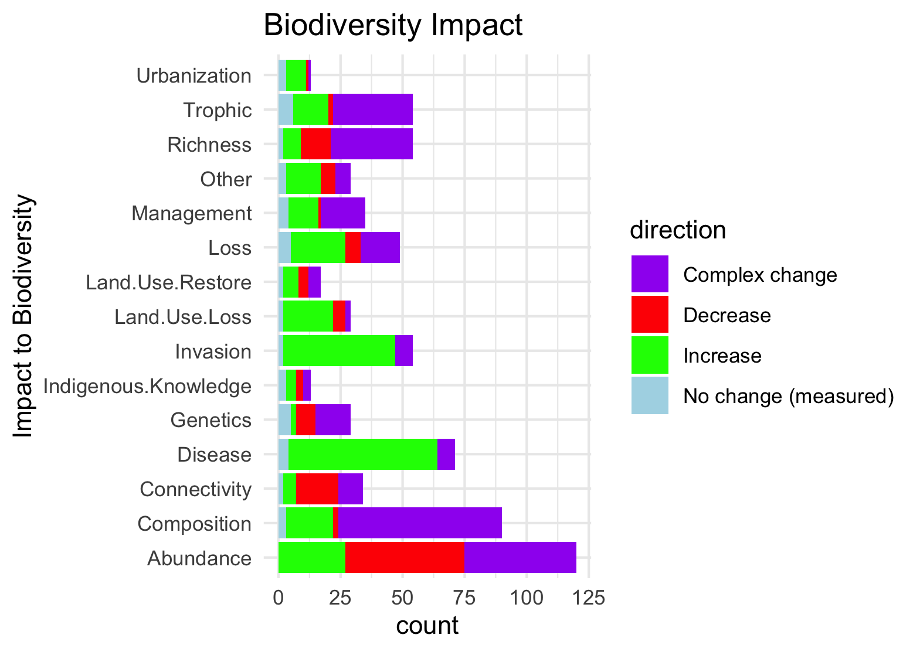
Needs to be grouped by what is good and what is bad to see increase in:

Slide 21
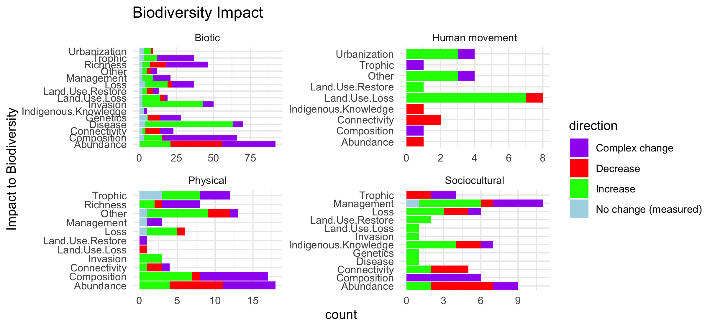
Scale free on the facet (diff x axis)

Slide 22
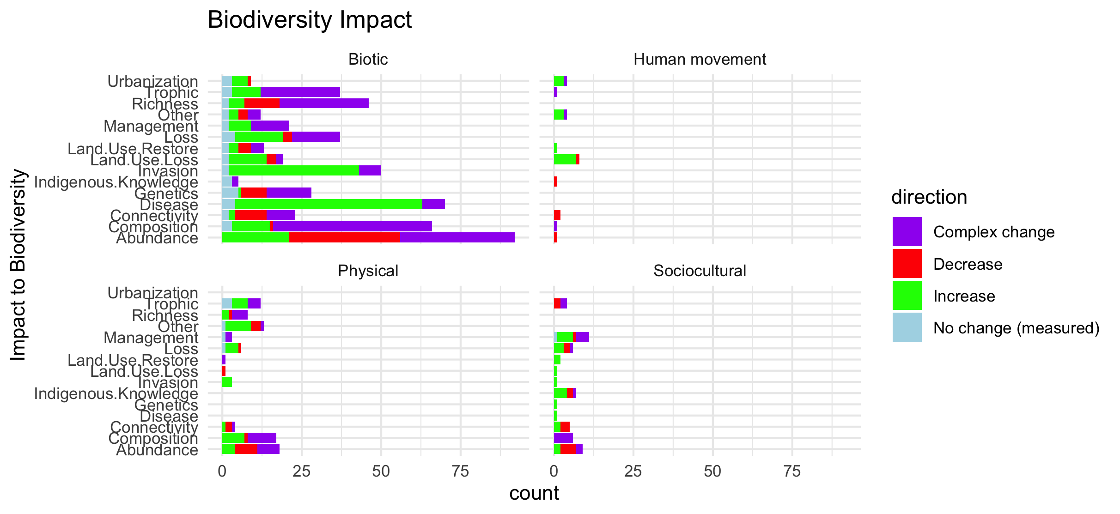
Scale fixed on the facet (same x axis)

Slide 23
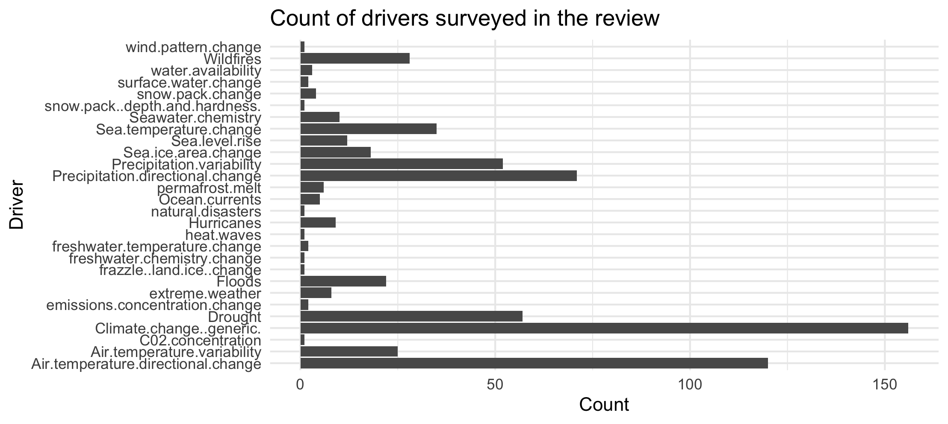

Slide 24
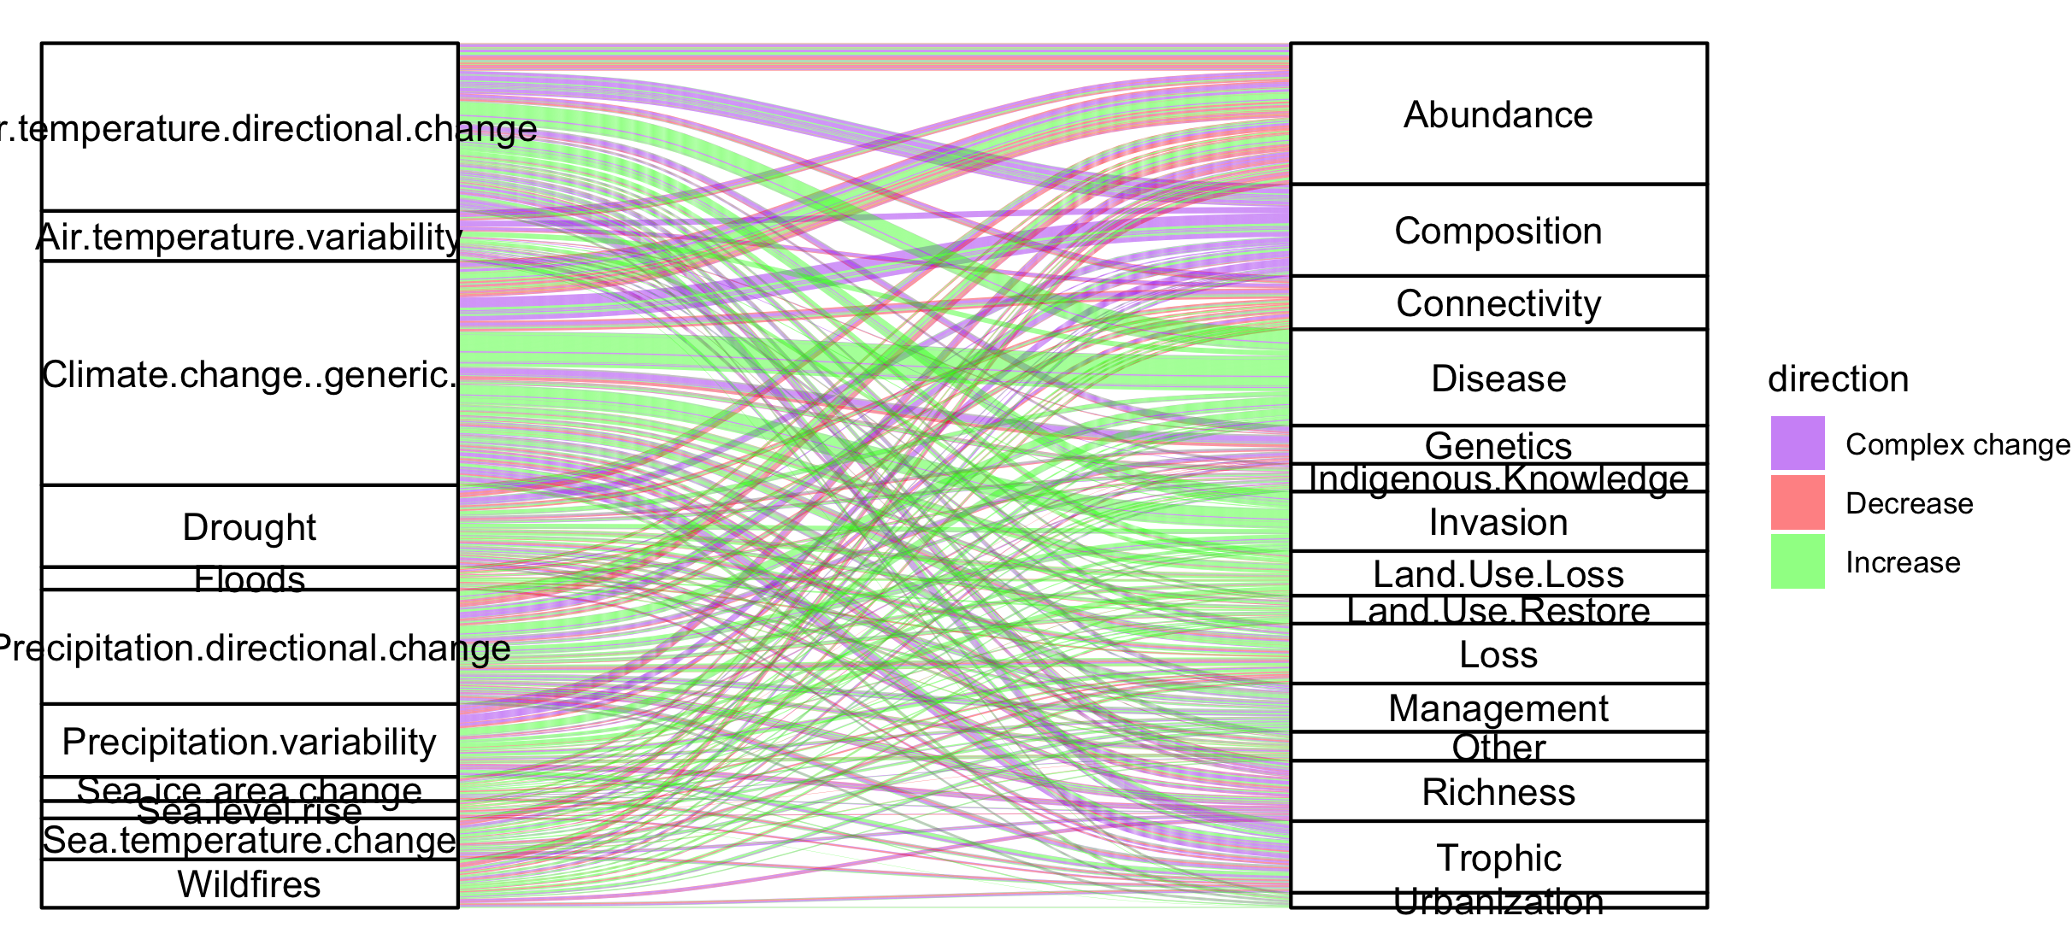
Colleen: see note isn the code – we could group spme of the drivers (hurricaines, extreme weather, ands ome of the ice ones). This still doesnt take into account if changes arw good or bad though and might just be too busy.

Slide 25
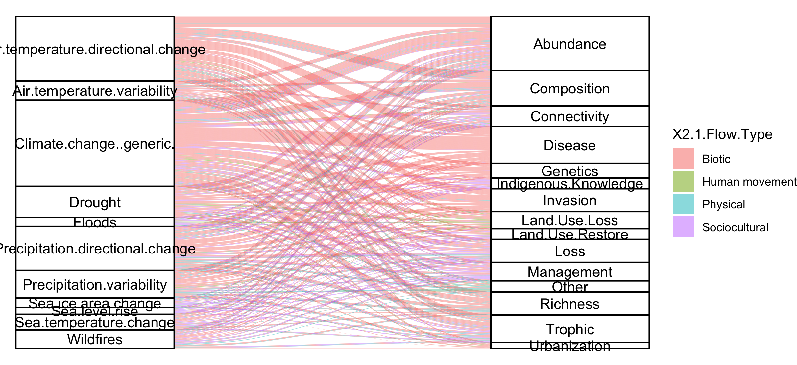
#not that informative because so many more of the papers are biotic

Slide 26
NCPs

Slide 27
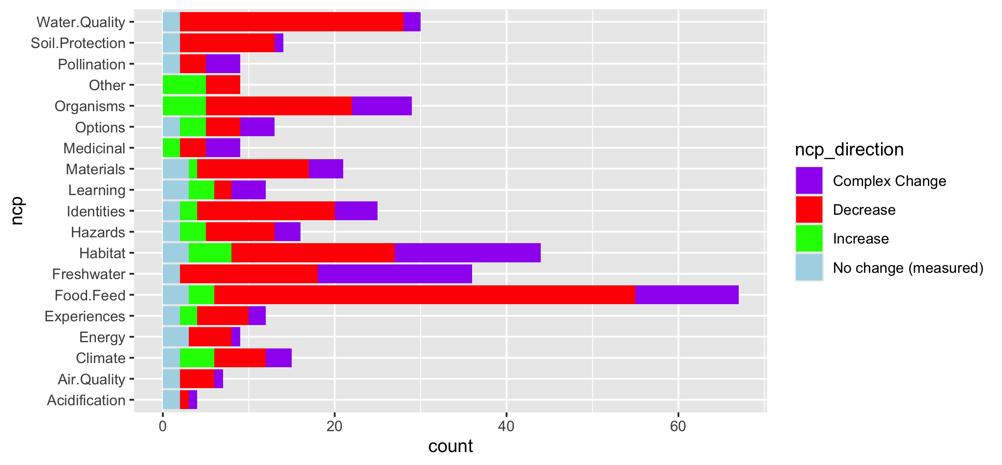
Fix labels

Slide 28
Do by flow type

Slide 29
Fix labels

Slide 30
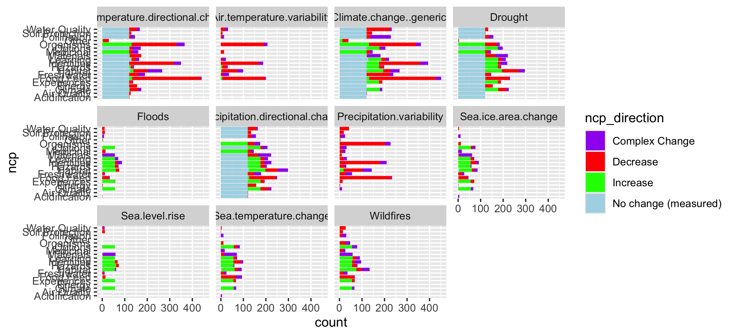

Slide 31
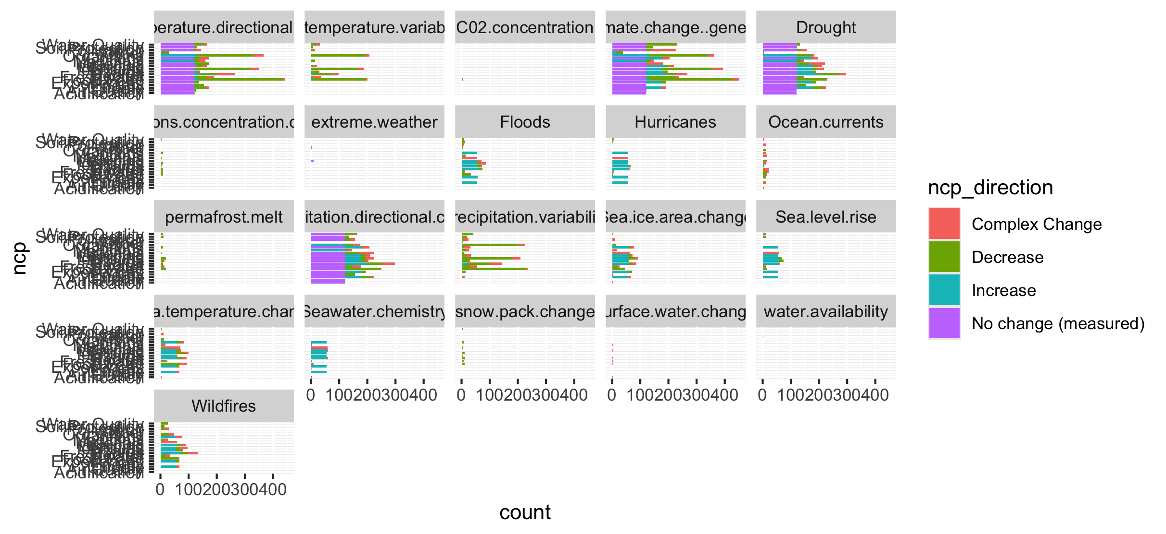
Too many drivers

Slide 32
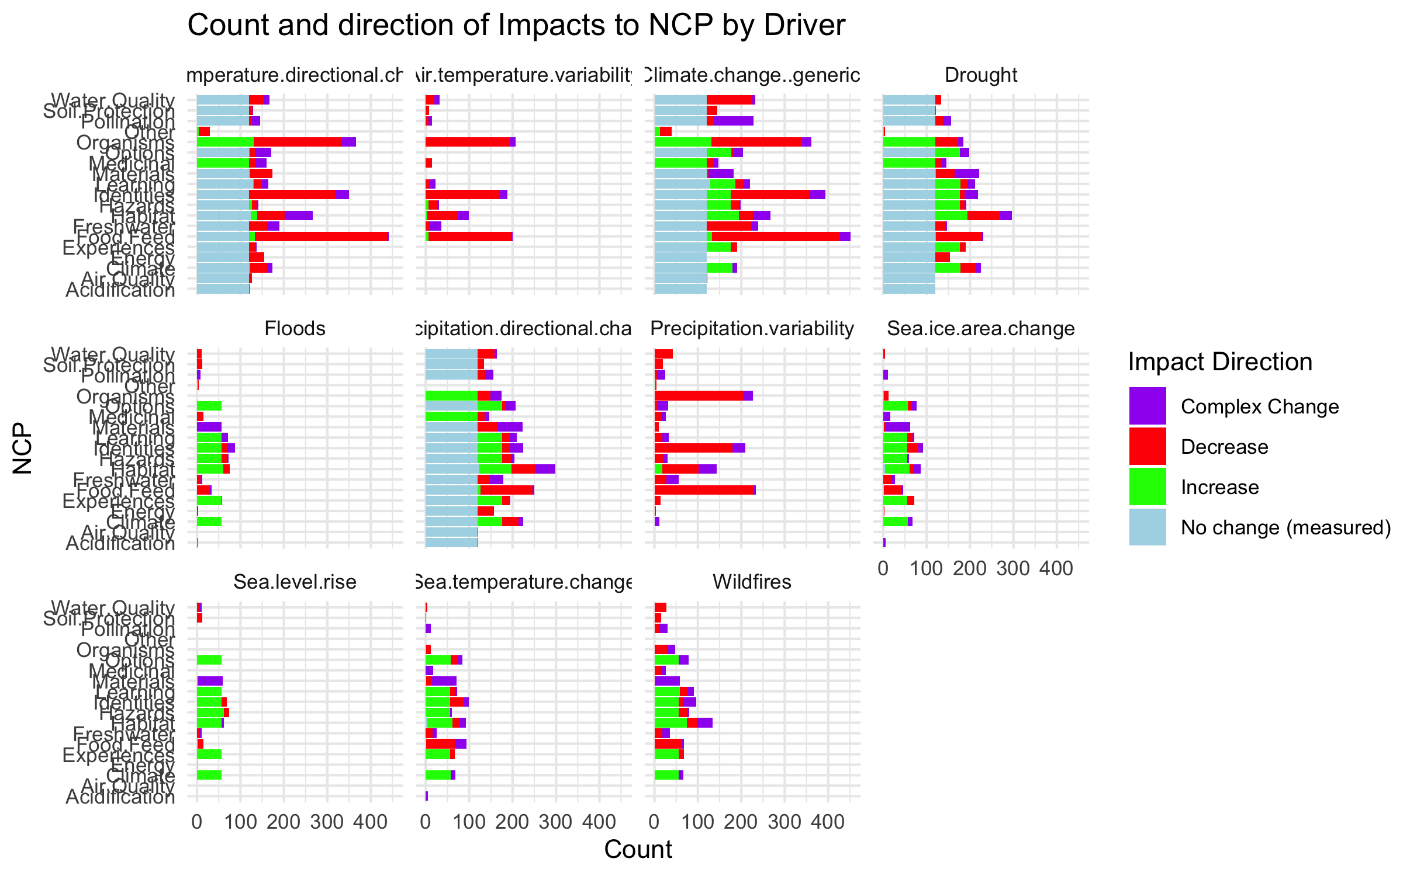

Slide 33
HWB

Slide 34
Connections – how does altered flow relate
Driver~ altered flow (by flow, and subflow – grouped out by flow
Altered flow~ impact (for each category)

